Slide 1
Validation of Las Vegas Basin Response to the 1992 Little Skull Mtn. Earthquake as Predicted by Physics-Based Nevada ShakeZoning Computations
Brady Flinchum¹, John Louie¹, Kenneth Smith¹, William Savran¹, Satish Pullammanappallil, Aasha Pancha²
¹Nevada Seismological Laboratory, University of Nevada Reno
²Optim Seismic Data Solutions, Reno, Nevada

Slide 2
Introduction
Nevada ShakeZoning (NSZ) is a CVM tool that can be used in seismic hazard analysis
Prediction of amplifications
Prediction of ground velocities
To validate NSZ we model the 1992 Little Skull Mountain (LSM) earthquake
Large earthquake close to Las Vegas
Excellent seismic coverage in Las Vegas Valley
Notes:
Works if we have proper basin geometry and velocity models.
Accurately predicts horizontal ground motions and amplifications at the calculated frequency.
LSM Is the larges earthquake in the southern great basin since 1996.
The seismic network in the LVV was operated by Blume and associates for the Atomic Energy commission.
The accelerometers were there to monitor basin response from nuclear tests at the Nevada Tests Site

Slide 3
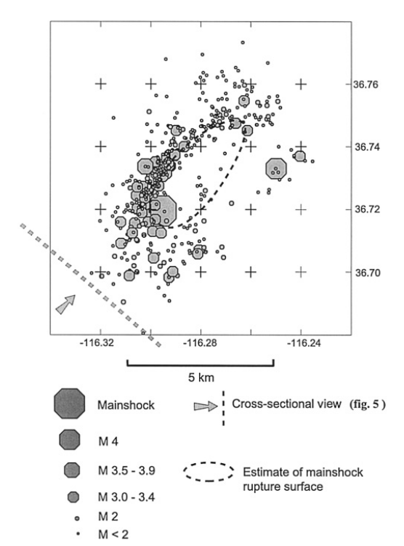
The Little Skull Mountain Earthquake
Epicenter is ~120 km Northwest of Las Vegas
Magnitude 5.6
Normal faulting with a small left-slip component
Strike: N60°E
Dip: 70°
Hypocentral depth: 11.7 km
Smith et al., 2001
Notes:
UNR determine the magnitude at 5.8 and the USGS determined the local magnitude at 5.6
Smith et All estimated the rupture area to be about 16 square kilometers.
This figure shows a figure from the smith et all paper, estimating the rupture area of the main shock displacement area.
We used a 4km by 4km grid dipping at 70 degrees to simulate the earthquake

Slide 4
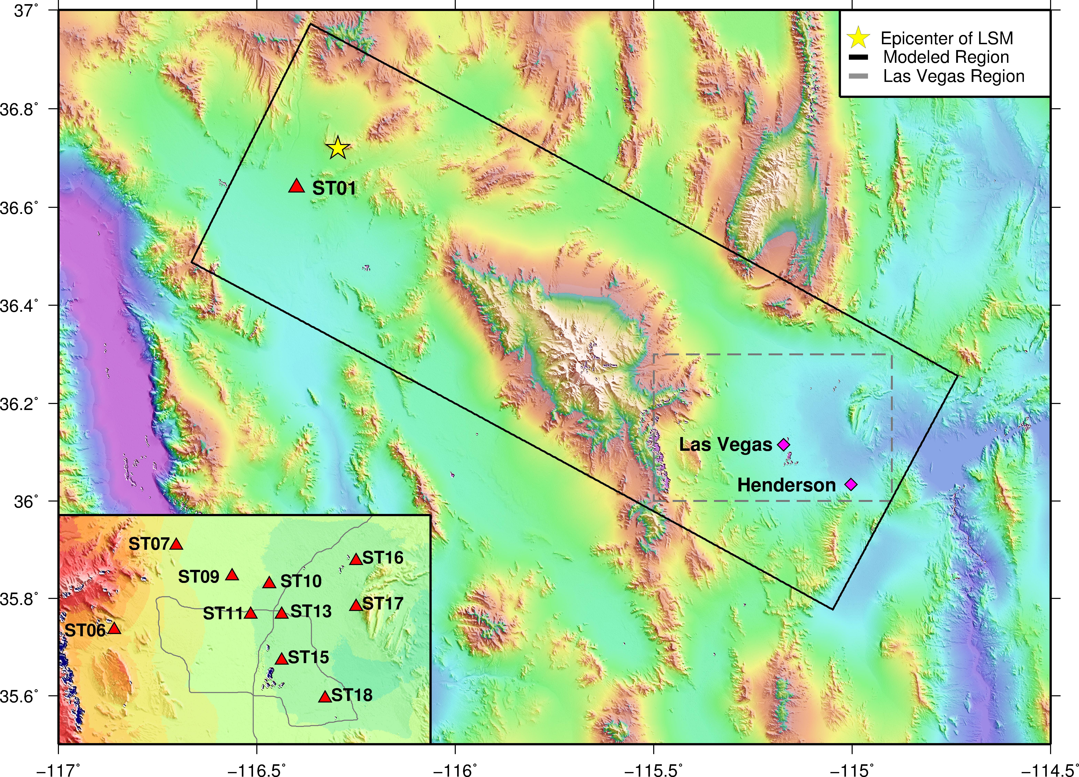
Model Area
Basin depth models from Saltus and Jachens, and Langenheim, USGS
Unique geotechnical coverage from Clark County Parcel Map
Notes:
The grid has an x-azimuth of 118 degrees
It is 60 by 165 km
The rotation of the rid allows us to shrink the model area and have the smallest grid spacing as possible.
This grid has grid spacing of 300 m
We assign default values of 760 m/s in rock and 500 m/s in basins, where the sediments are more than 10km thick
The velocities vary with depth but is uniform with respect to position.
We assign the values of the parcel map and override the default values. The Vs30 velocities are extended to Vs300 by using by averaging the lateral variable geotechincal velocities with the laterally homogeneous deep basin velocities.
With a grid spacing of 300m and the lowest default velocity being 360 m/s we can compute frequencies up to 0.12 Hz without grid dispersion artifacts.
ST01 was part of the Southern Great Basin Seismic Network and was one of 30 strong motion stations.
It played an important role in helping us calibrate our source for the model
NSZ does not account for topography

Slide 5
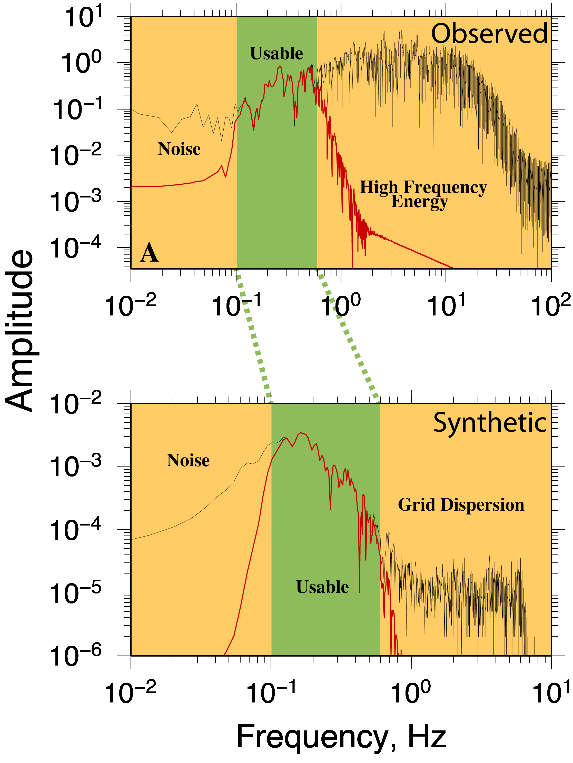
Data Processing
Rotate synthetic data to match North-South Data
Integrate observed data
SAC trapezoidal integration
Band-Pass Filter
Remove grid dispersion
Remove low-frequency noise
ST06
B
Notes:
Whenever we lined up a seismogram we lined them up by their p-wave arrivals.
In the observed data these were picked off of the raw seismograms
In the synthetic we picked off of the vertical component
Rotate the data
Convert the accelerations to velocities, SAC trapezoidal integration
Band-Pass Filter
0.1 to 0.6 was used because we wanted to filter out anything below 0.1 hz due to the sensitivity of the accelerometers in the BLUME network
Butterworth Filter
4 Poles
We filtered out everything over 0.6 hz to avoid grid dispersion artifacts in the model

Slide 6
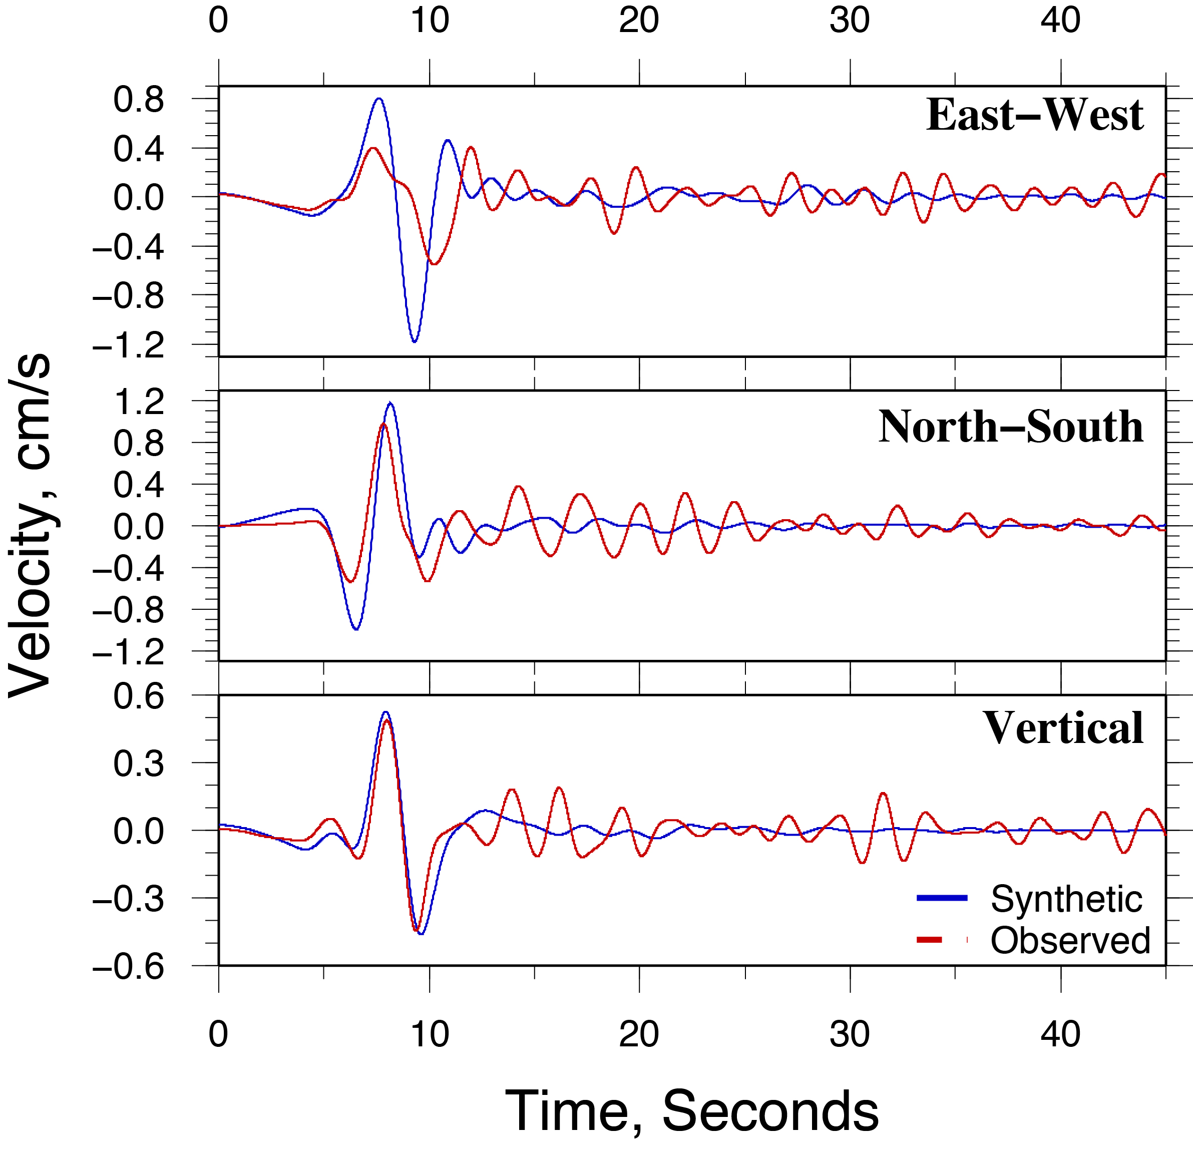
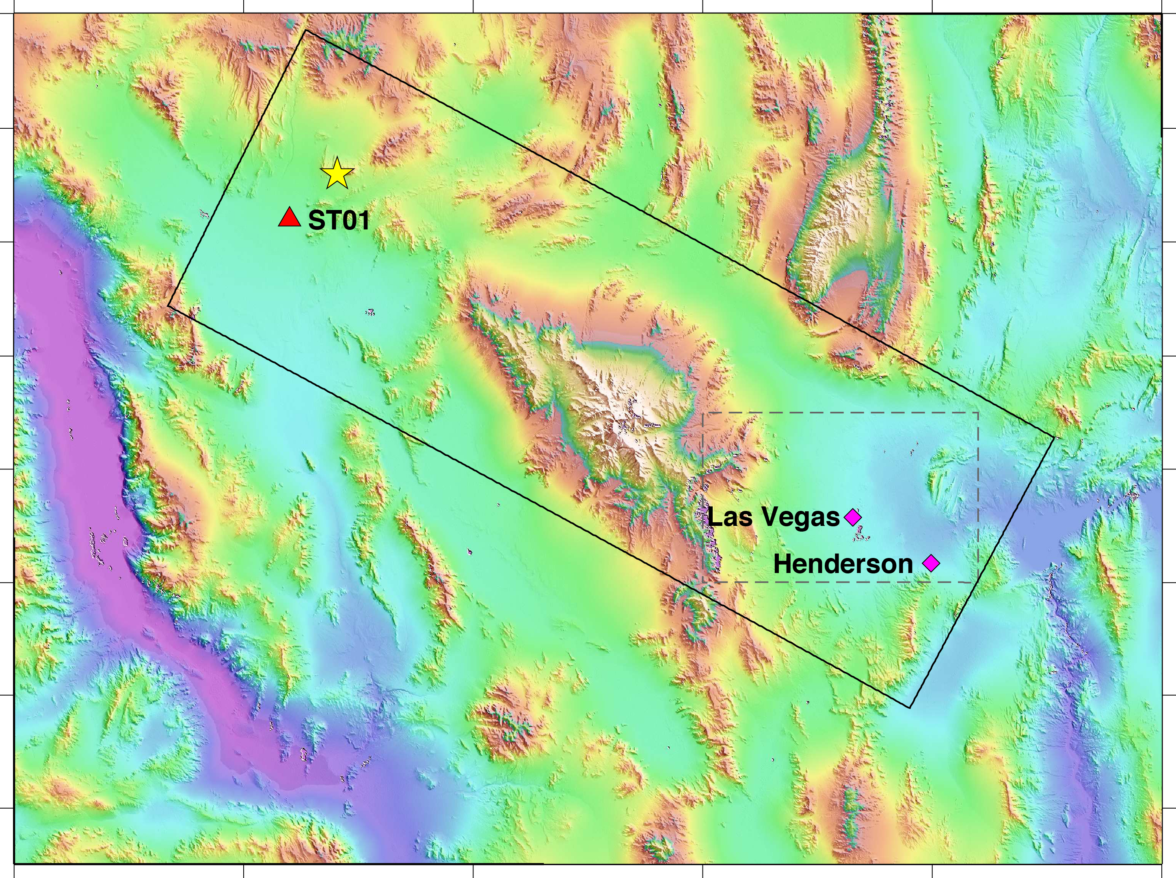
Calibration
Notes:
The amplitudes and shapes of the synthetics match the observed data extremely well
Our source parameters were correct. The vertical matches almost identically
The observed seismograms have energy at higher frequencies
This is to be expected because the filter doesn’t just cut off at 0.6Hz

Slide 7
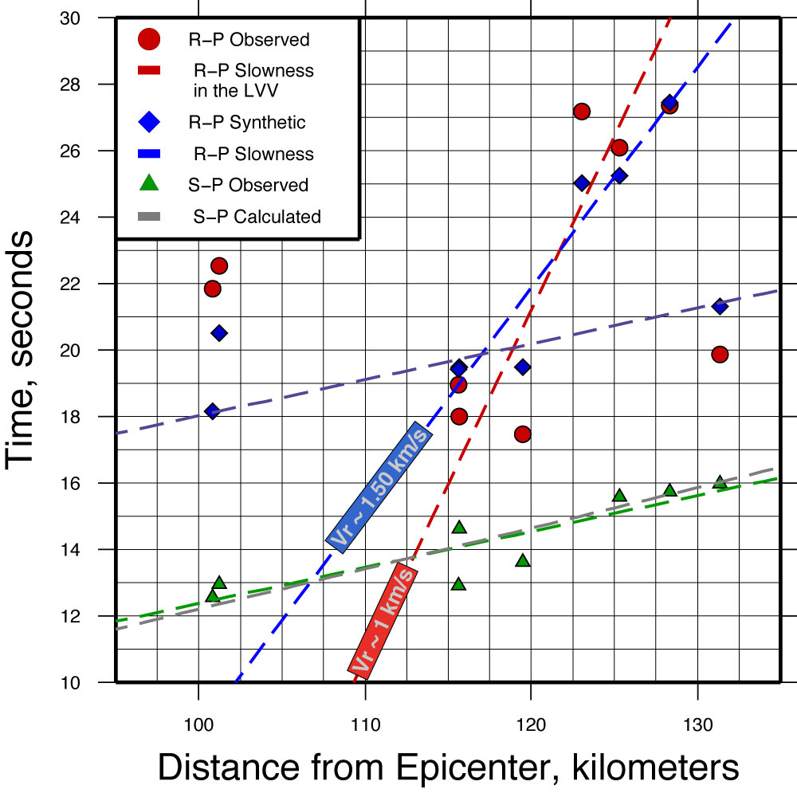
Differential Travel Times
Can’t see S waves in synthetic, used R-P times
R-P from source is sub-parallel to data S-P
R-P in Las Vegas basin is much slower, shows late phases
Notes:
This plot is showing the R-P arrival times of the synthetic and observed data
The green triangles are the S-P arrival times from the observed data.
In order to calculate the velocities we use this equation.
The equation can be rearranged to solve for the Rayleigh wave velocity
The first thing to note is the best fit line of the S-P arrivals is only off by about 5% against the assumed default P-S wave velocities.
NSZ estimation of default values are good
The next thing to note is the early arrival of Rayleigh wave arrivals in the observed data
This is conversion of p-s wave energy at the basin edge.
The converted rayleigh wave travels slower through the LVV
Slope of the blue line is 0.666*x – 58.0604 = 1.5015 km/s
We have one early arrival and one delayed arrival
We believe this is significant because we only have one point in the basin that satisfies the quarter wavelength rule of thumb.
Since we were picking the largest first arriving rayleigh wave we believe the energy of the converted rayleigh waves to be smaller than the rayeligh waves arriving from LSM directly

Slide 8
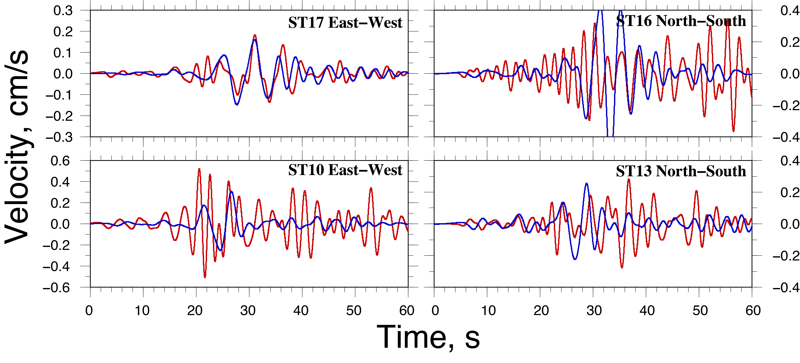
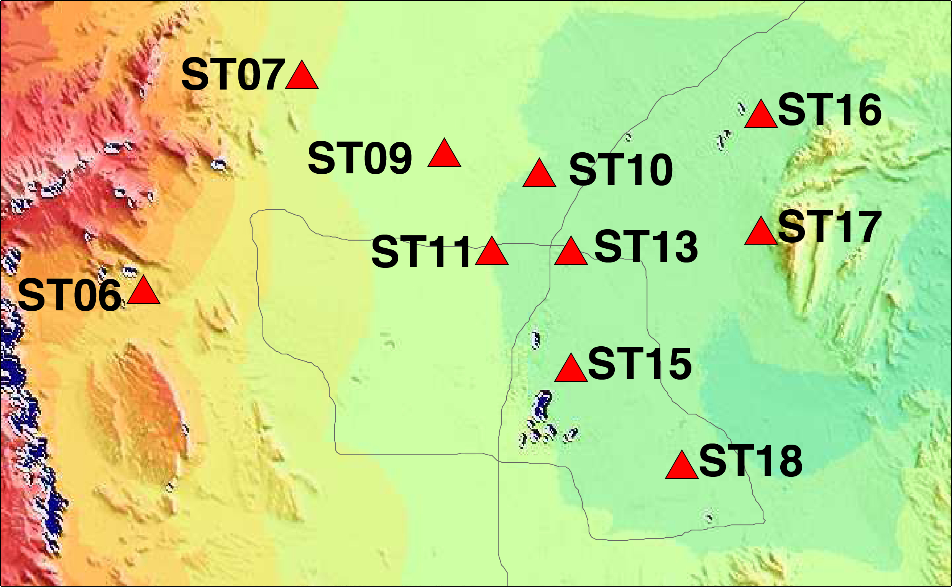
Seismograms

Slide 9
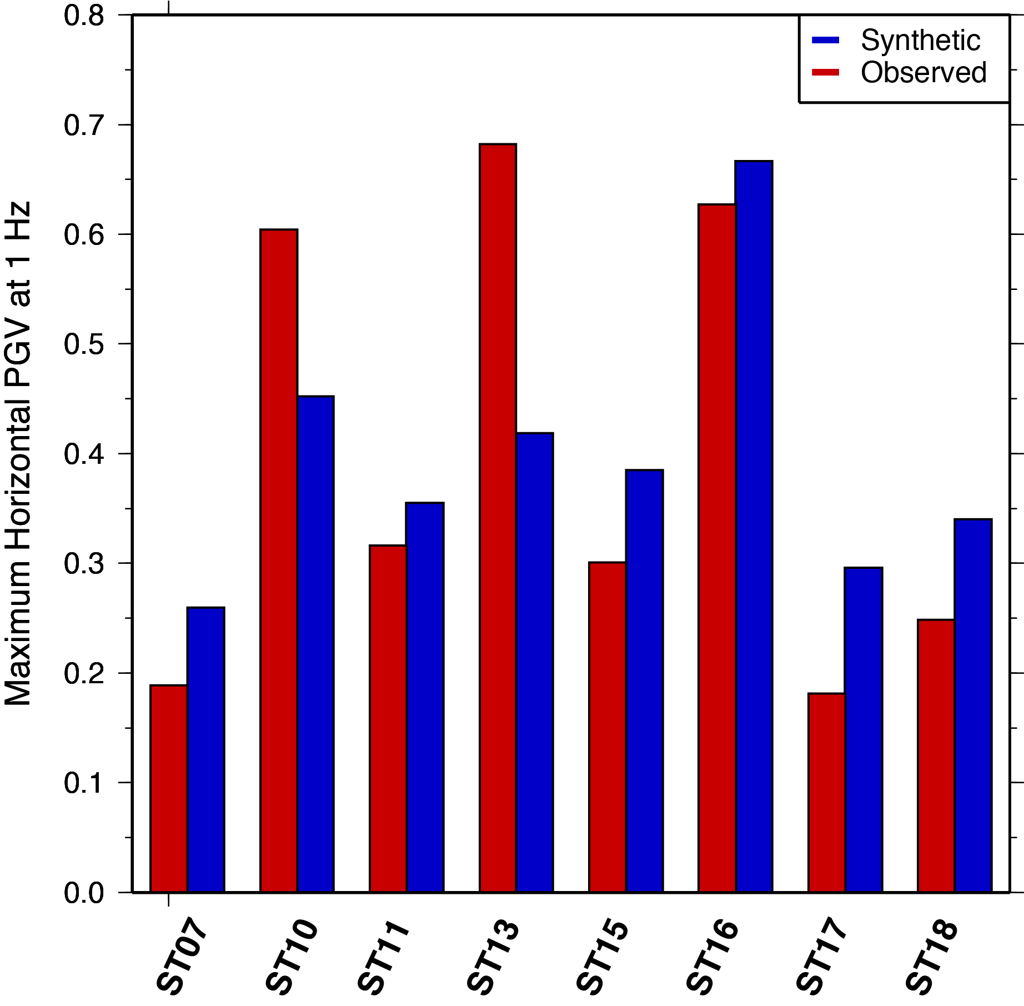
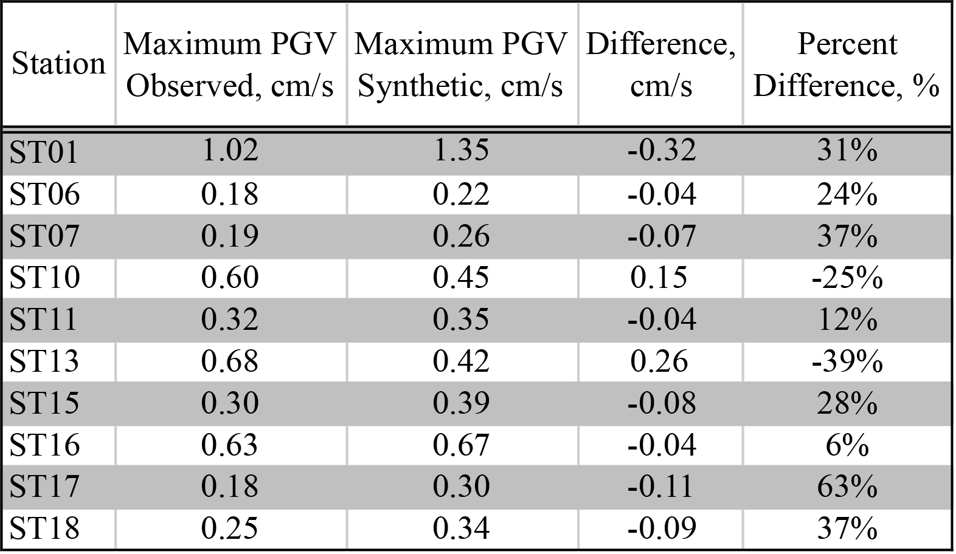
Peak Horizontal Ground Velocities
Notes:
All of our velocities compare within a factor of 2.
A zoomed in section of the stations are shown on the right.
The deepest part of the basin occurs at ST16
We believe our velocities to be lower than the observed because of the frequency dependence
Rodgers et all and Sue et All found the maximum velocities occurring between 0.2-0.33 hz. Our synthetic model lacks in these areas

Slide 10
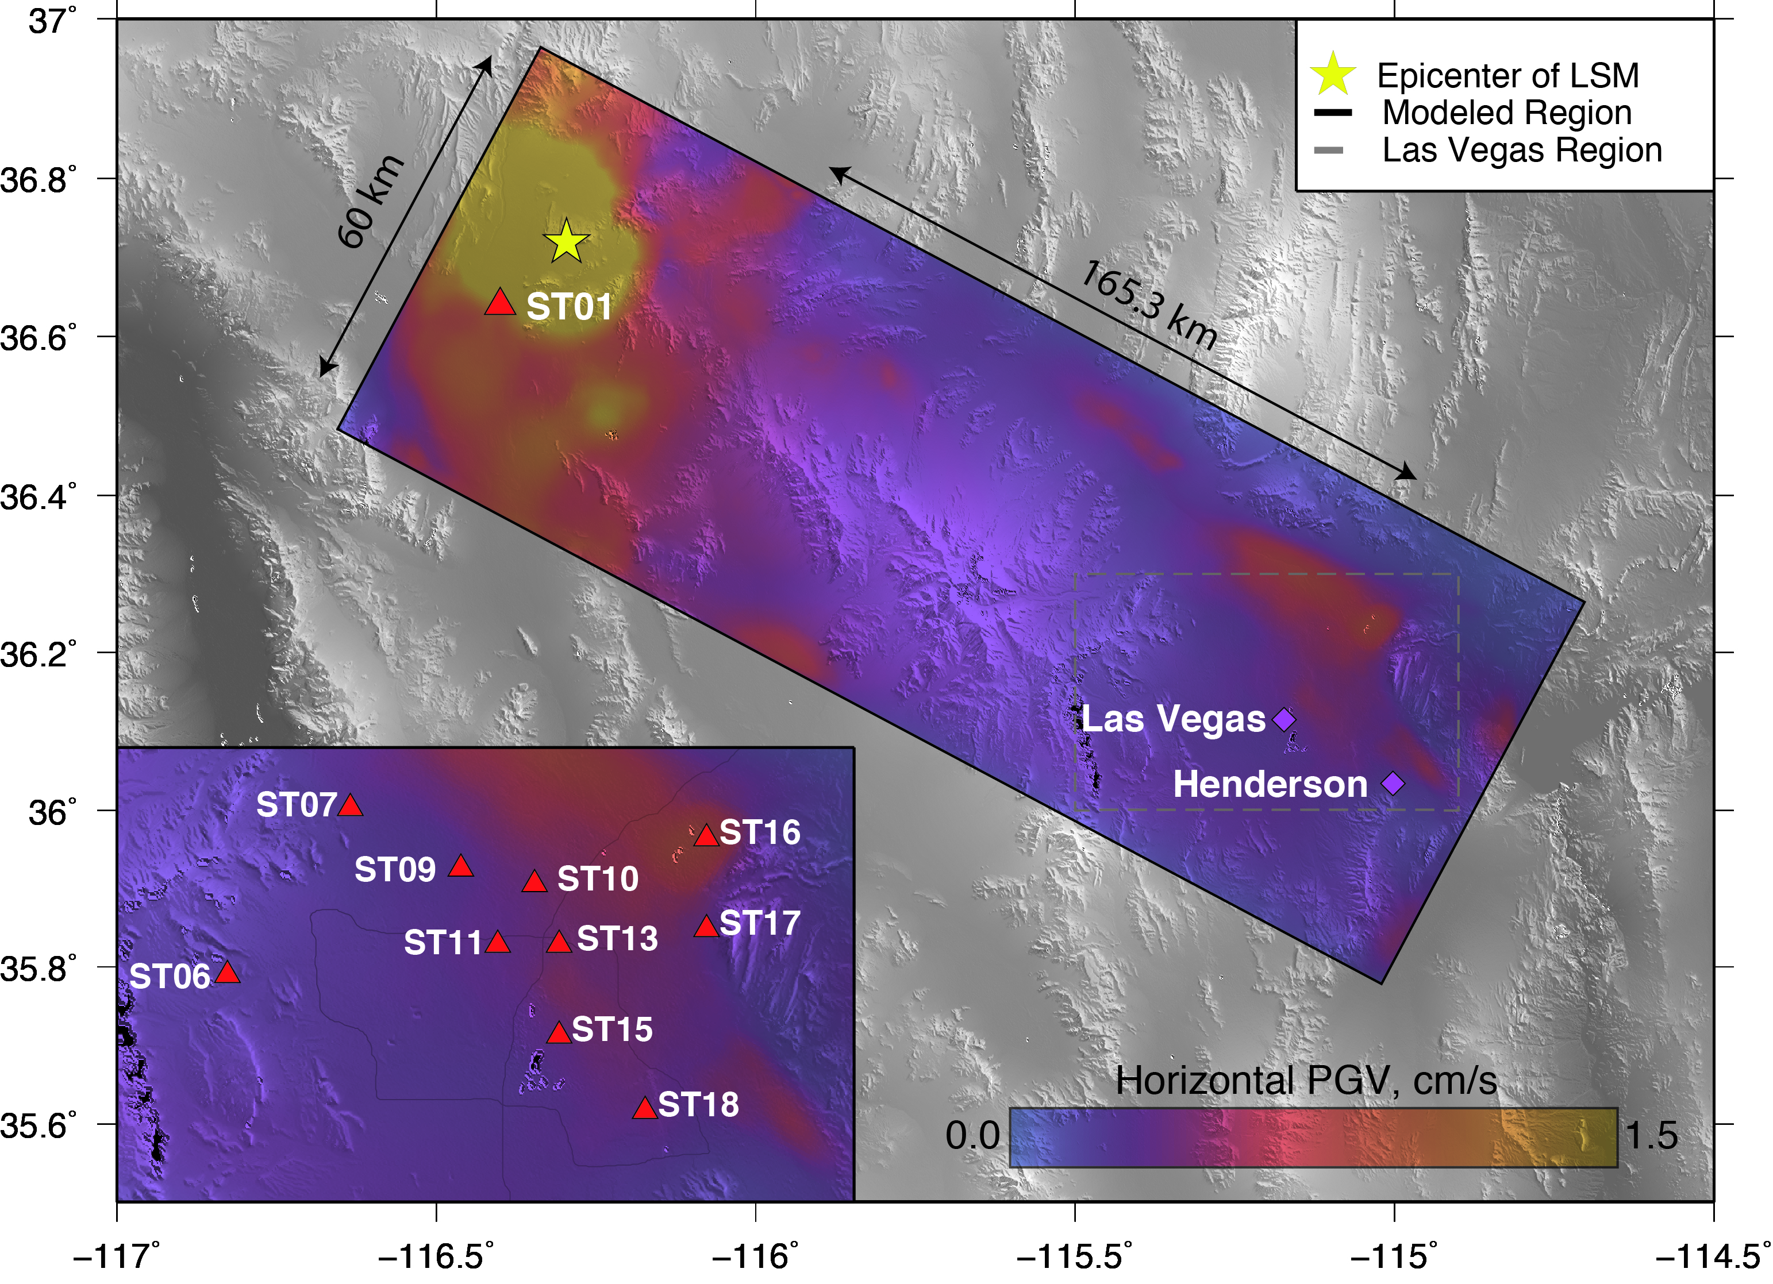
Peak Horizontal Ground Velocities
Channeling along basins from USGS
Notes:
This is a standard output of NSZ.
We can see than even though NSZ does not account for topography, the basin inputs keep the seismic energy in the basin and guide it to the LVV
Notice the shaking is the strongest at the deepest part of the Eastern valley, and almost no shaking in the western valley
We know that the western side of the basin is on colleche, which is much harder than the sediment and has higher seismic velocites, as seen from the parcel map.

Slide 11
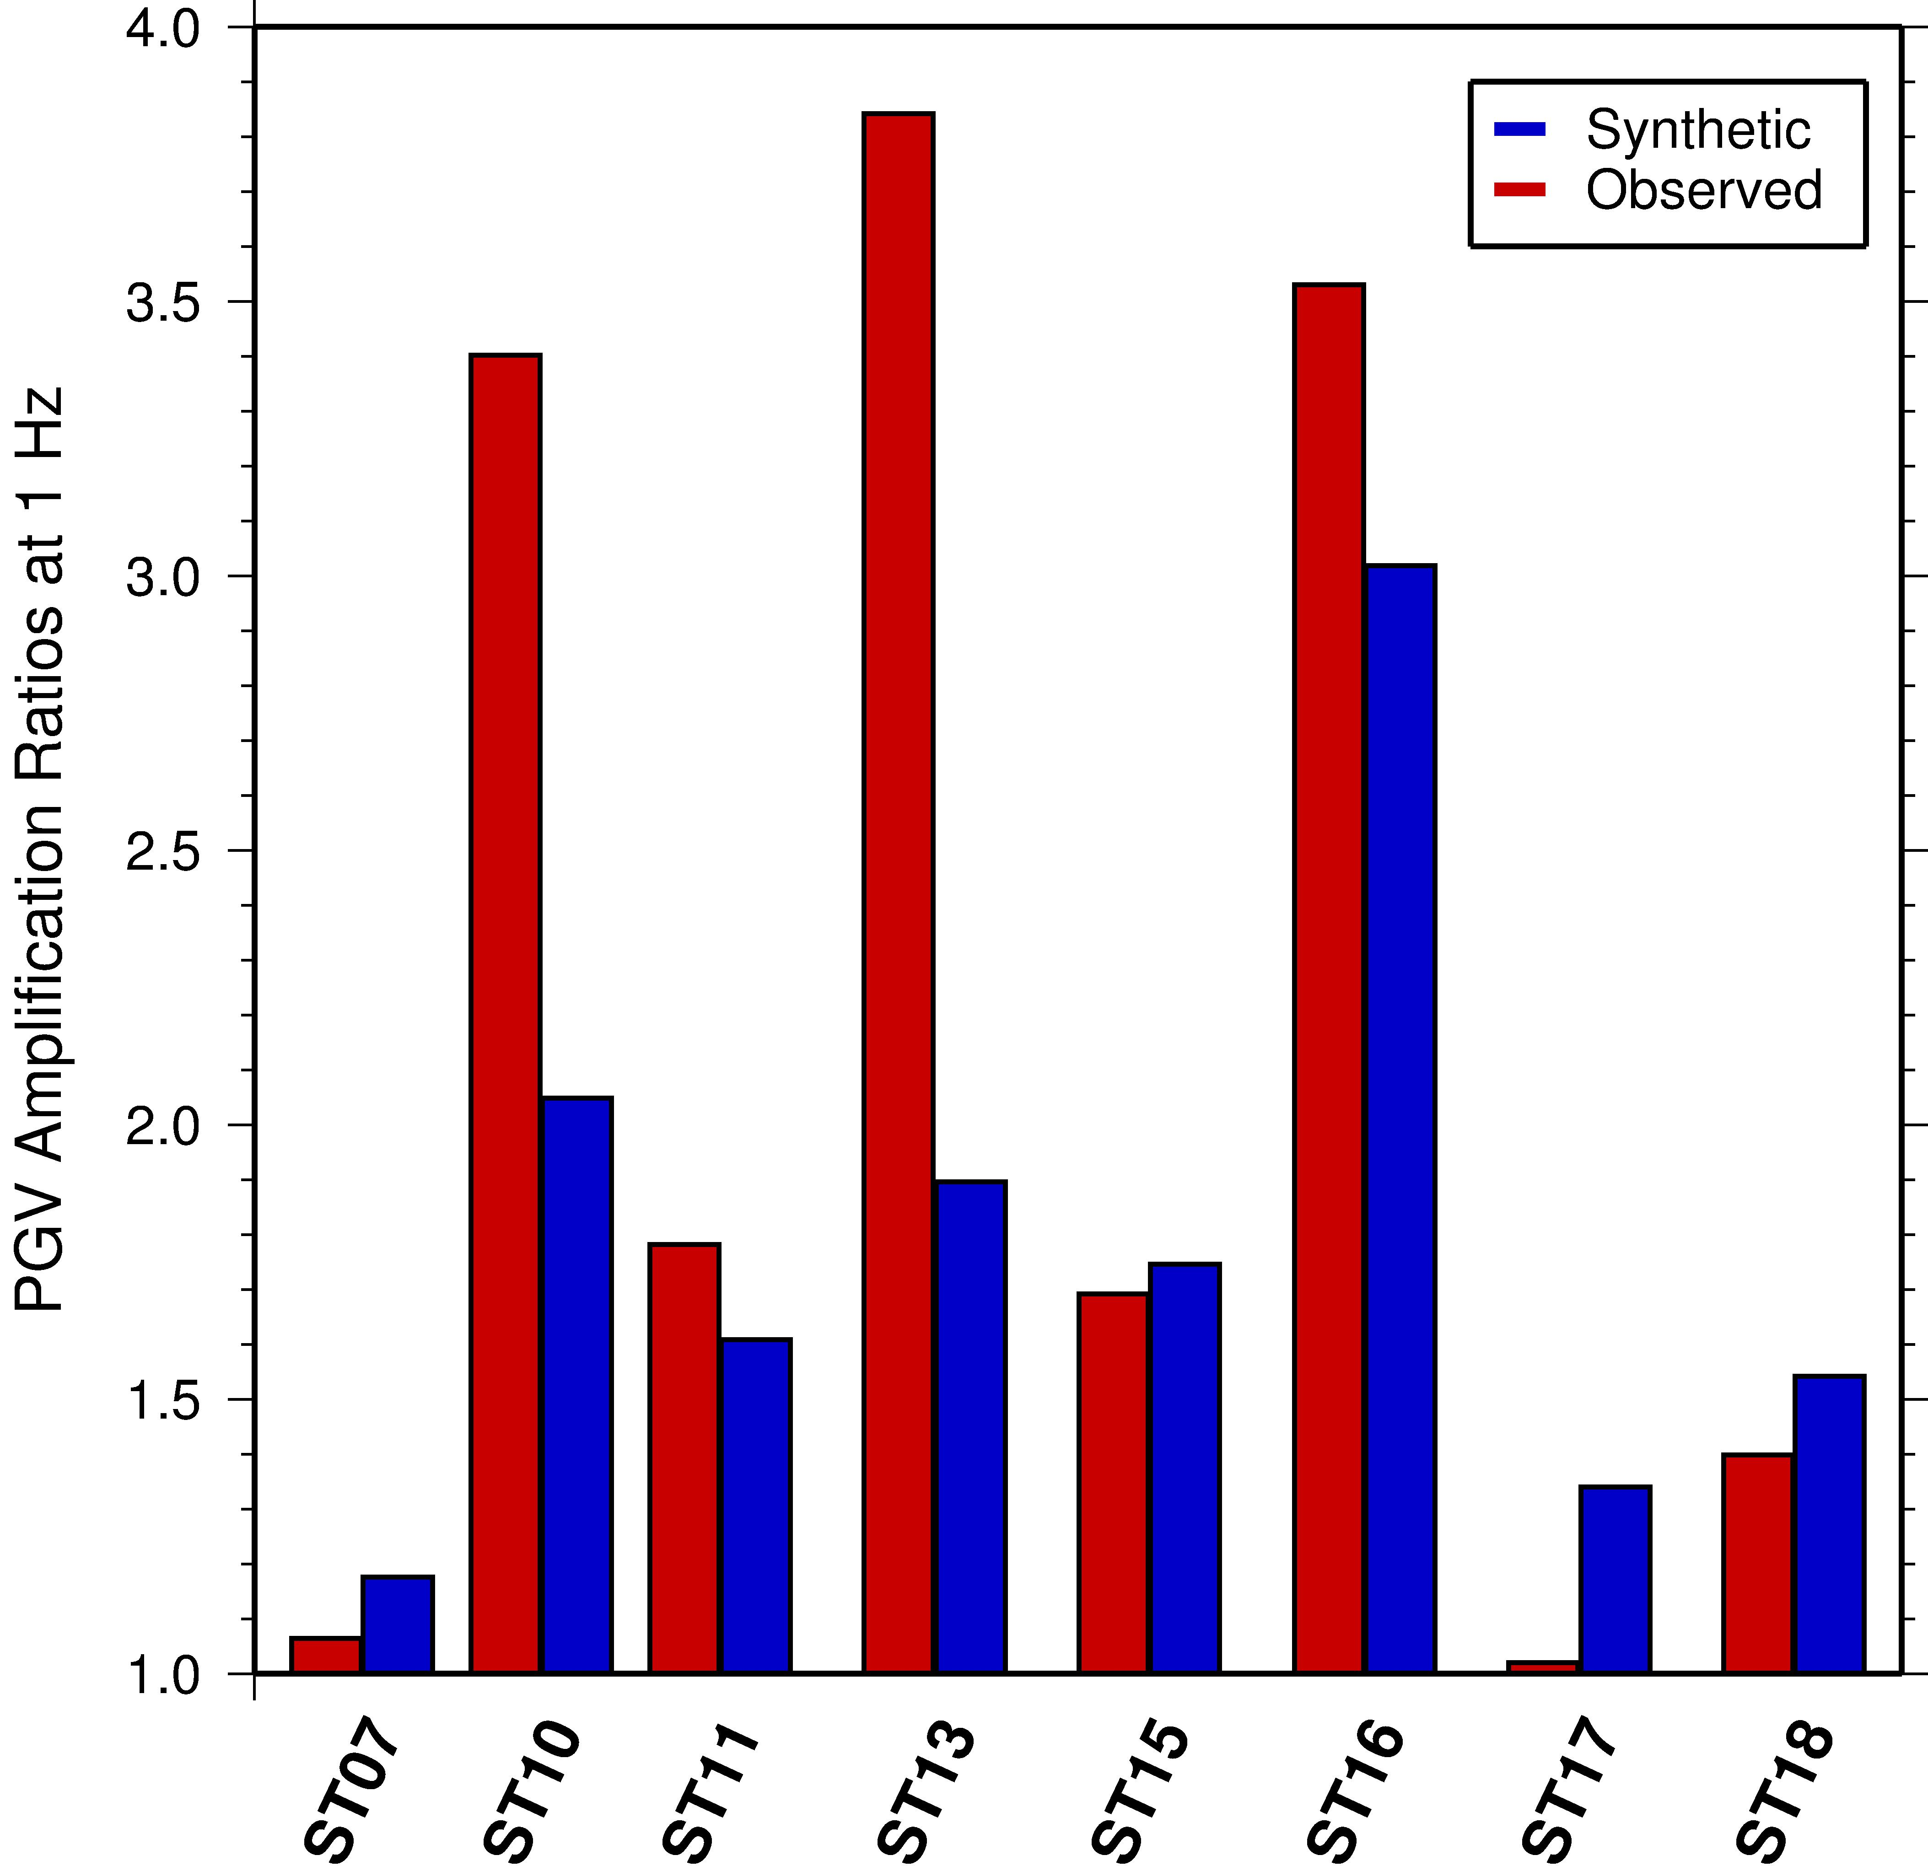
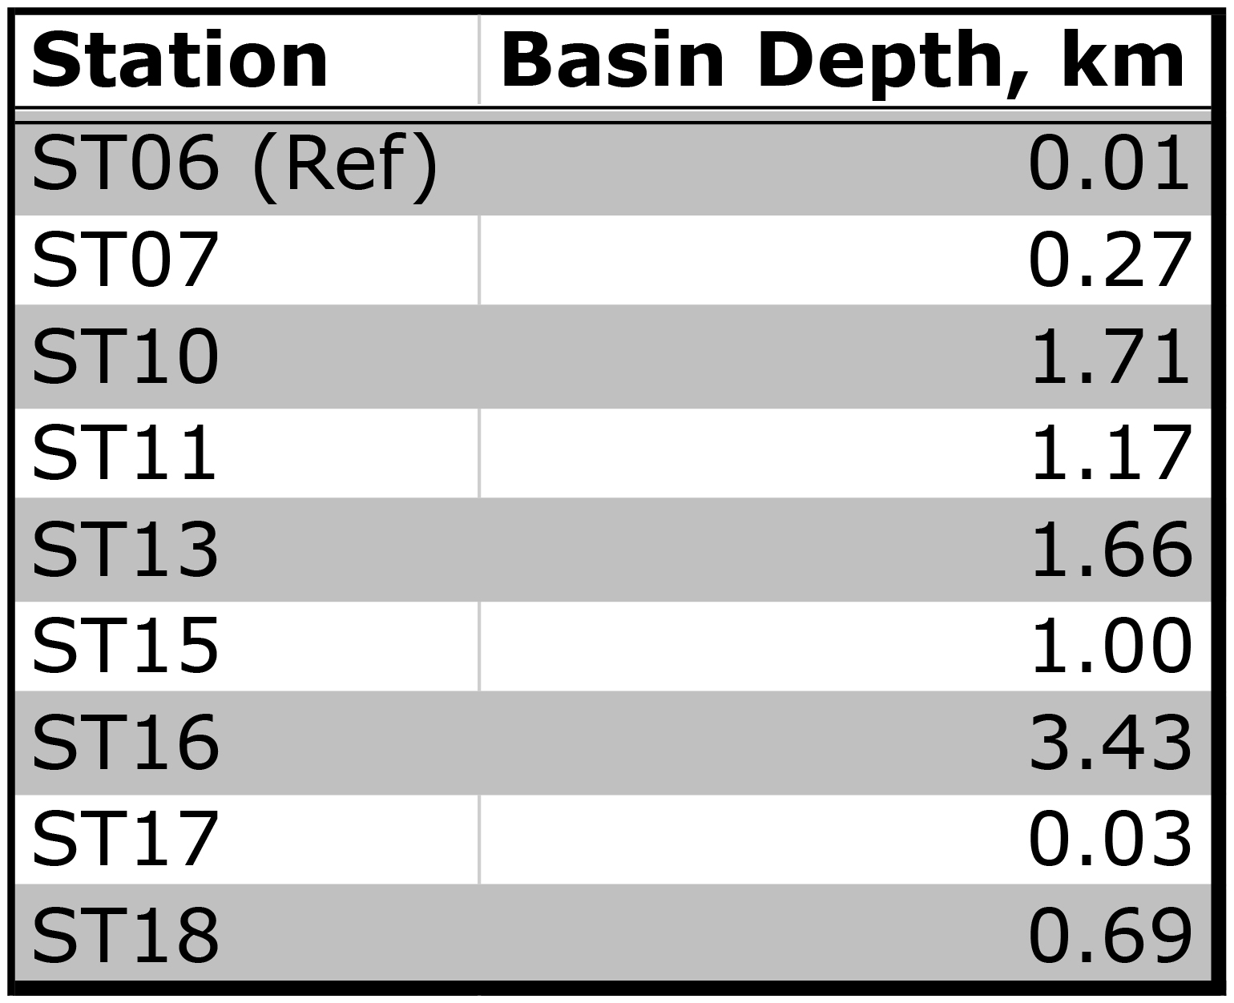
Horizontal Ground Amplification
Notes:
All of these amplifications are taking with respect to ST06
Note that basin depths are each station are shown in the table on the right.
Our amplifications vary but match up almost identically at ST16
If we use the quarter wavelenth assumption at 0.1 Hz and an assumed velocity of 2.6 km/s the basin, the wave would be 28km, which would put ¼ of the wavelenghth at about 7km.
This explains why our amplifications are off sometimes
If we use the quarter wavelength of a 0.2 Hz wave at the same velocity, for maximum amplification the basin would have to be about 3.5 km thick

Slide 12
Conclusion
NSZ CVM uses detailed geotechnical and basin maps
Predicts 0.1-Hz horizontal ground motion accurately for the Las Vegas Region
Validated with 1992 Little Skull Mountain records
Predicts areas of high amplification for the Las Vegas region
crack.seismo.unr.edu/NSZ

Slide 13
References
Rodgers, Arthur, Hrvoje Tkalcic, David McCallen, Shawn Larsen, and Catherine Snelson, 2006, Site response in Las Vegas Valley, Nevada from NTS explosions and earthquake data: Pure & Applied Geophysics, 163, 55–80.
Smith, K. D., Brune, J. N., dePolo, D., Savage, M. K., Anooshehpoor, R., and Sheehan, A. F., 2001, The 1992 Little Skull Mountain earthquake sequence, southern Nevada Test Site: Bulletin of the Seismological Society of America, 91(6), 1595-1606.
Langenheim, V. E., Grow, J., Miller, J. J., Davidson, J. D., and Robison, E., 1998, Thickness of Cenozoic deposits and location and geometry of the Las Vegas Valley shear zone, Nevada, based on gravity, seismic-reflection, and aeromagnetic data: U.S. Geol. Survey Open-File Report OF98-0576, 32 pp.
Saltus, R. W., and Jachens, R. C., 1995, Gravity and basin-depth maps of the Basin and Range Province, Western United States: U.S. Geological Survey, Geophysical Investigations Map, Report: GP-1012, 1 sheet.
Goldstein, P., and A. Snoke, 2005, SAC availability for the IRIS community: Incorporated Institutions for Seismology Data Management Center Electronic Newsletter, http://www.iris.edu/news/newsletter/vol7no1/page1.htm.
Larsen, S., Wiley, R., Roberts, P., and House, L., 2001, Next-generation numerical modeling: incorporating elasticity, anisotropy and attenuation: SEG Expanded Abstracts, 20, 1218-1221.

